Slide 1

The Elastic Stack as a SIEM
Philly Security Shell 2019

Slide 2
Who Am I?
John Hubbard [@SecHubb]
Previous SOC Lead @ GlaxoSmithKline
Certified SANS Instructor
Author
SEC450: Blue Team Fundamentals – Security Analysis and Operations
SEC455: SIEM Design & Implementation (Elasticsearch as a SIEM)
Instructor
SEC511: Continuous Monitoring & Security Operations
SEC555: SIEM with Tactical Analytics
Mission: Make life awesome for the blue team
Data for this talk: https://github.com/SecHubb/SecShell_Demo

Slide 3
What is a SIEM?
Log Sources
Log Storage & Indexing
Search, Visualization, & Alerting
Log Aggregation / Queue
A central log repository that enriches logs and assists threat detection
Components
Log Sources
Log Aggregator
Log Storage & Indexing
Search & Viz. Interface + Alerting Engine

Slide 4


What is the Elastic Stack?
Open source, real-time search and analytics engine
Made up of 4 pieces: collection, ingestion, storage, and visualization

Slide 5
History of Elastic
2010
Created by Shay Bannon
Recipe search engine for his wife in culinary school
Inspired by Minority Report
2012
Elastic Co. Founded
2019
Used by Wikipedia, Stack Overflow, GitHub, Netflix, LinkedIn, …
One of the most popular projects on GitHub
Iterating versions rapidly with awesome new features

Slide 6




Elastic Stack vs. SIEM
Log Sources
Log Storage & Indexing
Search, Visualization, & Alerting
Log Aggregation / Queue

Slide 7

Elastic stack as a SIEM
Used for many different use cases
NOT a SIEM out of the box
Not in the magic quadrant as one
Can do the things a SIEM does
Gartner's definition of a SIEM:
"supports threat detection and security incident response through the real-time collection and historical analysis of security events from a wide variety of event and contextual data sources. It also supports compliance reporting and incident investigation through analysis of historical data from these sources."

Slide 8
Elasticsearch as a SIEM
Collects, indexes, and stores high volumes of logs
Functional visualizations and dashboards
Reporting and alerting
Log enrichment through plugins
Compatible with almost every format
Log retention settings
Anomaly detection via machine learning
RBAC securable

Slide 9
Elastic Stack Overview
Raw Logs
Raw Logs
Log Ingestion & Parsing
Search & Visualization
Log Storage

Slide 10



Beats Agents
Lightweight log agents written in Go
Filebeat
Winlogbeat
Packetbeat
Auditbeat
Functionbeat
Journalbeat
Community Beats
Winlogbeat
Packetbeat
Filebeat

Slide 11
Elasticsearch Architecture

Slide 12


Clusters, Nodes, and Indices
Cluster
Node
Indices

Slide 13
Index Creation Across Time
Firewall-2018-01
Firewall-2018-02
Firewall-2018-03
IDS-2018-01
IDS-2018-02
IDS-2018-03

Slide 14


Shards and Documents
Index
Shards
Documents

Slide 15

Why Elasticsearch is so fast?

Slide 16


Reason 1: Schema on Ingest
Many SIEMs:
Schema applied at search time
Elasticsearch:
Schema applied at ingestion

Slide 17
Reason 2: Data is distributed
Index
Shards
Nodes

Slide 18
Shard Types
Primary Shards
Like RAID 0 – Need all shards to make the whole index
Replica Shards
Like RAID 1
Each primary shard has arbitrary number of copies
Each copy can be polled to balance search load

Slide 19
Shards
All shards belong to and make up an index
Enables arbitrary horizontal scaling
Spread evenly across all available hardware
Designated a Primary or Replica
Full Index
Data
Primary Shard 1
Primary Shard 2
Primary Shard 3
Replica Shard 1
Replica Shard 2
Replica Shard 3

Slide 20
Primaries and Replicas
Copy 1
Copy 2
P0
P1
R0
R1
Shards
Nodes

Slide 21
Primaries and Replicas
Copy 1
Copy 2
Copy 3
P0
P1
R0
R1
R0
R1
Shards
Nodes

Slide 22
Balancing Writes
Incoming Logs
P0
P1
P2
P3
P4
P5
Shards
Nodes

Slide 23
Balancing Searches
Search Requests
P0
R0
R0
R0
R0
R0
Shards
Nodes

Slide 24
Balancing Searches: multi-shard
Search 1
Search 2
Search 3
P0
P1
R0
R1
R0
R1
Shards
Nodes

Slide 25
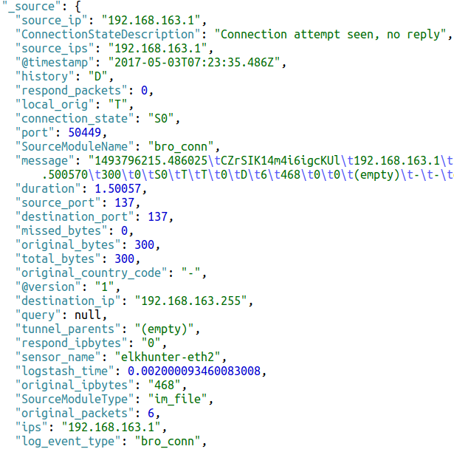
Documents to Fields
Document
Single Log
(Converted to JSON by Logstash)
Fields

Slide 26
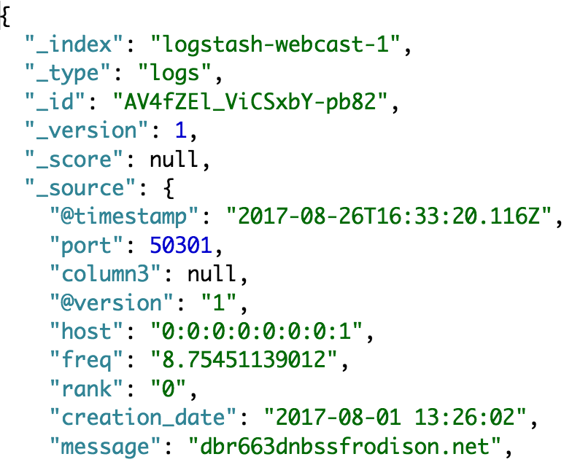
Documents
Indices hold documents in serialized JSON objects
1 document = 1 log entry
Contains "field : value" pairs
Metadata
_index – Index the document belongs to
_id – unique ID for that log
_source – parsed log fields

Slide 27
Fields and Mappings
Field – A key-value pair inside a document
username: admin
hostname: web-server1
Mapping - Defines information about the fields
Think "database schema"
The data type for each field (integer, ip, keyword, etc.)

Slide 28
Key Concept: Keyword vs. Text
String datatypes are either text or keyword, or both!
Keyword indexes the exact values
Example: Usernames, ID numbers, tags, FQDNs
Binary search results – full exact matches, or not
Text type breaks things up into pieces
Example: "http://www.mywebmail.com/mailbox/mail1.htm"
Allows searching for "http", "www.mywebmail.com", "mailbox", "mail1.htm"
Fed through an "analyzer"
This data type cannot be aggregated / visualized

Slide 29
Text Data Type Example
http://www.mywebmail.com/mailbox/mail1.htm
Character Filter
http www.mywebmail.com mailbox mail1.htm
Tokenizer
Tokens can be searched for
http www.mywebmail.com mailbox mail1.htm

Slide 30
Where Tokens Go: Inverted Index
Lucene builds "inverted index" of tokens in text field data
Doc 1: "The woman is walking down the street."
Doc 2: "The man is walking into the store."
Tokens | Doc 1 | Doc 2
the | x | x
woman | x
is | x | x
walking | x | x
down | x
street | x
man |  | x
into |  | x
store |  | x

Slide 31
Elasticsearch Term Summary
Cluster = Multiple Nodes
Node
Elasticsearch instance
Index
Index
Holds one log type
Shard
Shard
Shard
Shard
Partial index
Lucene
Lucene
Lucene
Lucene
Search engine
"Inverted index"
Segment
Segment
Segment
Segment
Segment
Segment
Segment
Segment
Segment
Segment
Segment
Segment

Slide 32
Kibana

Slide 33
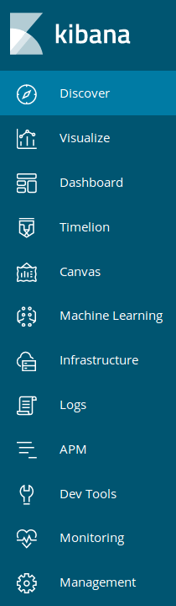
Kibana Interface
Discover - Search and explore data
Visualize - Create graphs and charts
Dashboard – Display a collection of saved items
Timelion – Unique time series data visualization
Canvas – New visualization type
Machine Learning – Ponies and magic
Infrastructure – Monitor all Metricbeats
Logs – Watch logs streaming from Filebeat
Dev Tools – Console for API access
Monitoring – Health of your cluster/agents/logstash
Management – Manage the cluster

Slide 34
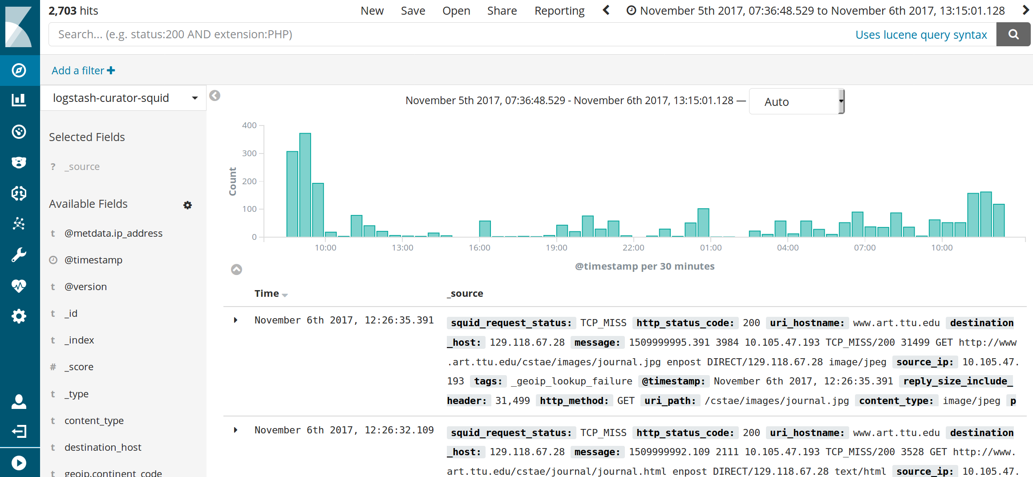
Using the Discover Tab
Time filter
Index pattern
Histogram
Field list
Document data

Slide 35
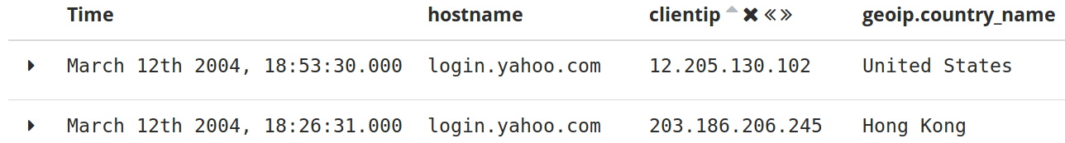
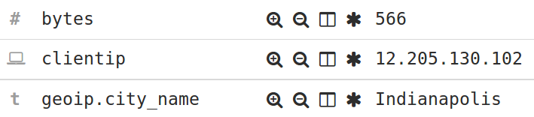
Discover Tab Details
Show document
Filter for this field value
Filter out this field value
Move left/right
Add as column
Remove this column
Data type
Field must exist
Sort by this column

Slide 36
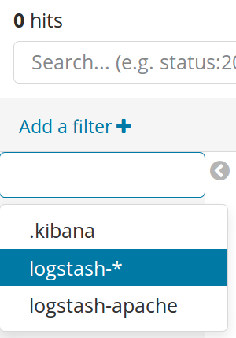
Index Patterns
Kibana must be told to show an index for searching
Searching can be performed on more than 1 index at once
Example usage:
"*" - Search ALL indices
"firewall-*"
"firewall-pfsense-*"
"firewall-pfsense-2019-*"
"alexa-top1M"

Slide 37
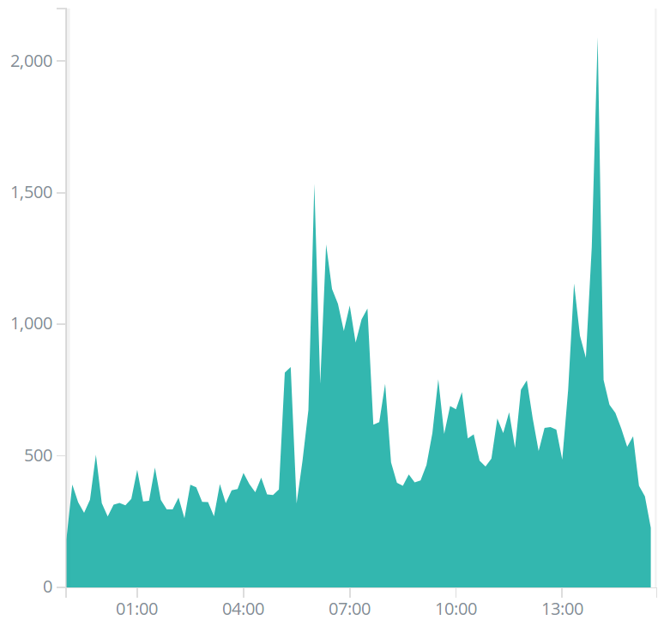
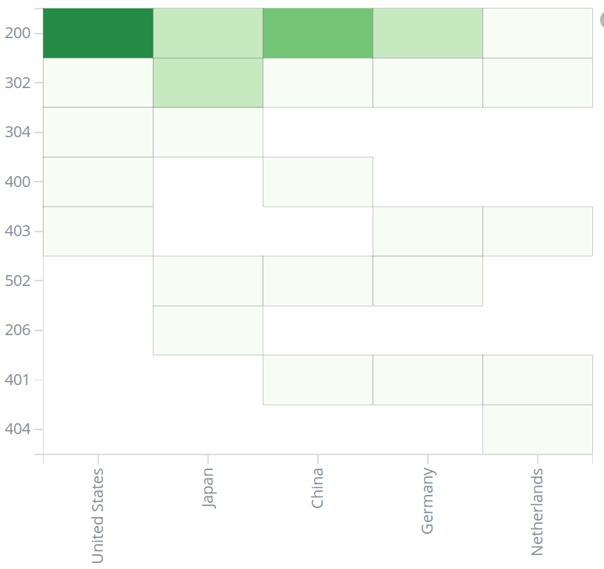
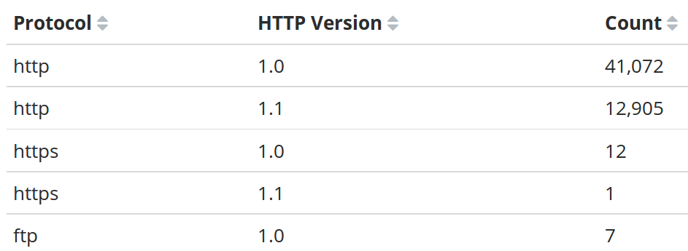
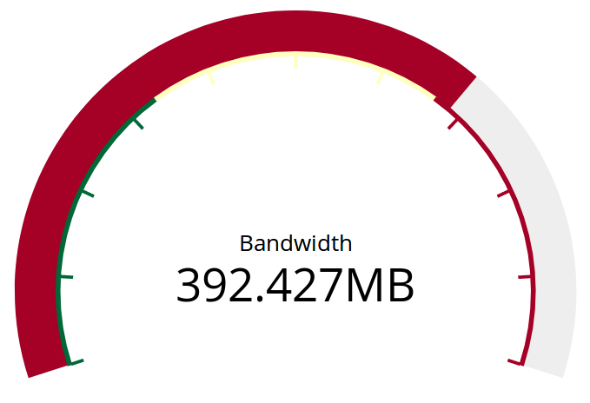


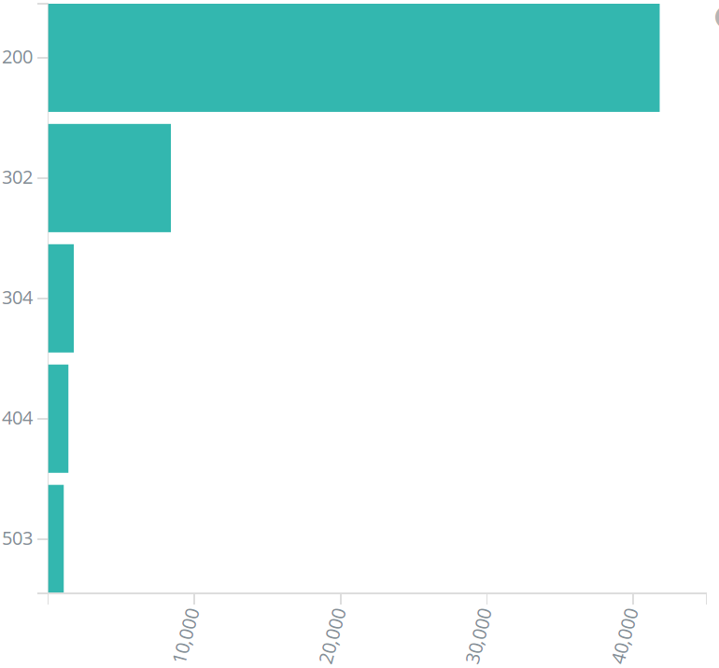
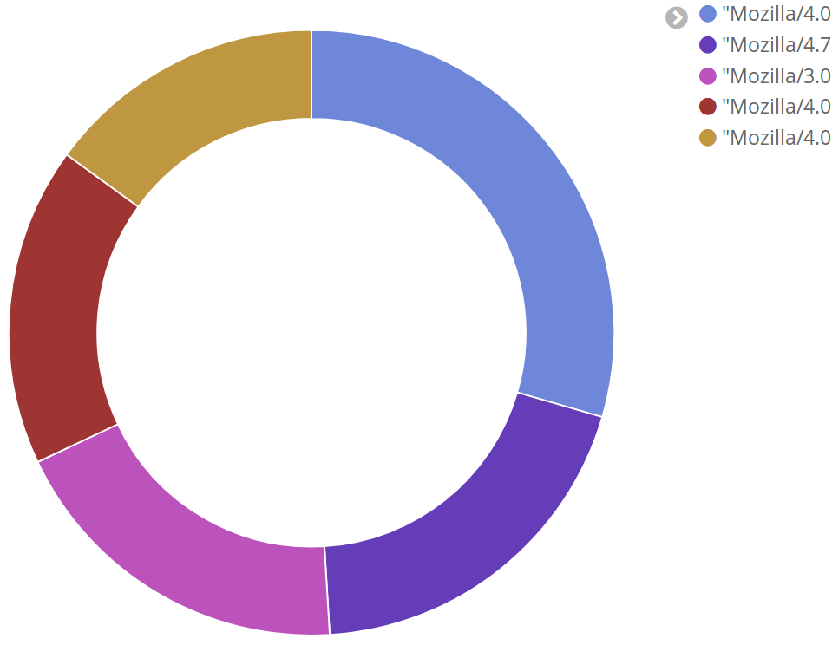
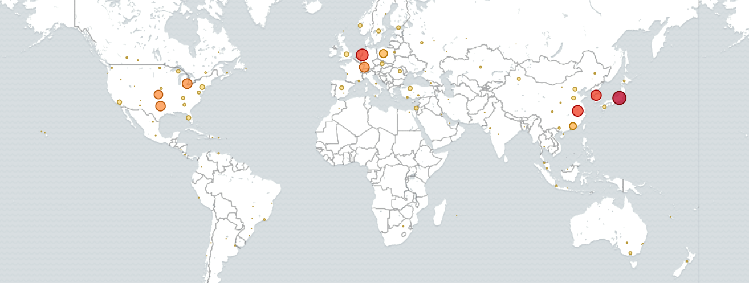
Visualization Types

Slide 38
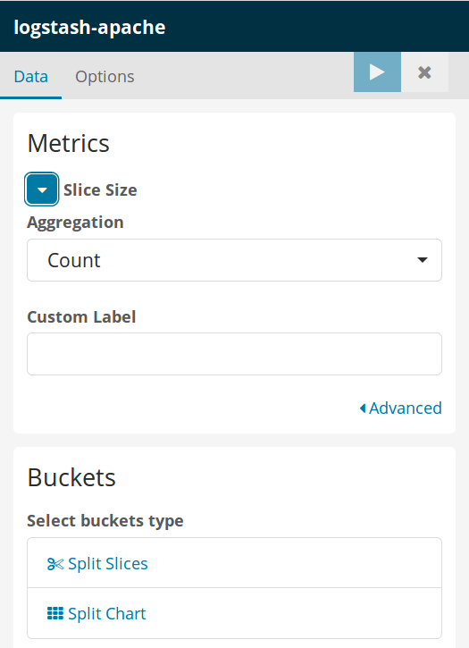
Creating Visualizations
Metrics: What to calculate
Buckets: How to group it
"I want to see <metric> per <bucket>"
"Total bytes"
"Total bytes per username"
"Request count, bytes per HTTP method"
"Requests per user per site"

Slide 39

Bucket Options
Date Histogram (time)
Date Range
Filters
Histogram
IPv4 Range
Range
Significant Terms
Terms (log fields)

Slide 40
Visualization Demo

Slide 41
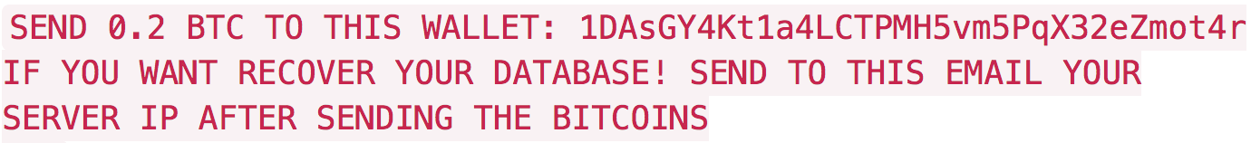
Default Elasticsearch Security
Elasticsearch is completely open by default

Slide 42



Options for Security
N00b mode: nginx reverse proxy with basic auth
Better:
Best:

Slide 43
Logstash

Slide 44
Logstash
Free, developed and maintained by Elastic
Integrates with Beats
Integrates with Elasticsearch
Tons of plugins
Easy to learn and use
Built-in buffering
Back-pressure support

Slide 45

Logstash – Ingestion Workhorse
Syslog
Other
TCP
UDP

Slide 46




Routing to Logstash
Logstash01
Logstash02
Load Balancer
Logstash03

Slide 47


Input -> Filter -> Output
Logstash has 3 components:
Input - Methods to listen for and accept logs
Filter - Filters, parses, and enriches logs
Output - Sends logs to another system or program
Logstash Pipeline
Input plugins
Filter plugins
Output plugins
Log source
Log destination

Slide 48
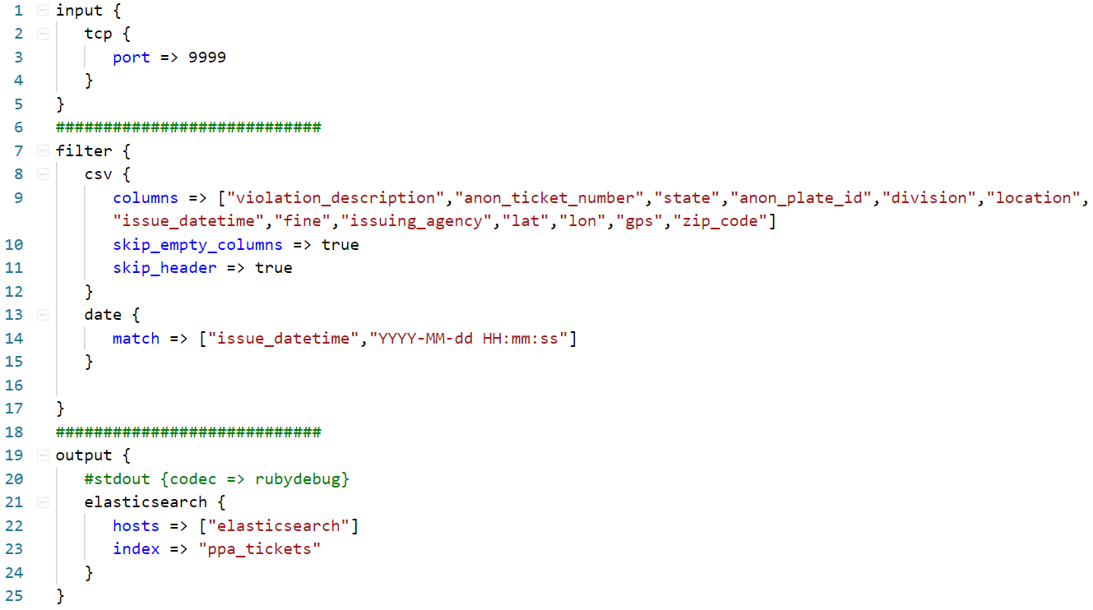

Logstash Config Files
For our premade configs, see: https://github.com/HASecuritySolutions/Logstash

Slide 49
Data Ingestion Demo

Slide 50
Input Plugins
Input receives logs in multiple formats
Key plugins:
Common options – beats, syslog, file, http, tcp, udp, elasticsearch
Database – jdbc, sqlite
Message Brokers – kafka, redis, rabbitmq
Input plugins
Filter plugins
Output plugins

Slide 51
Filter Plugins
Filter section parses, filters, and enriches logs
Key plugins:
Parsing - csv, grok, kv, json, syslog_pri, xml, date
Log filtering - drop
Enrichment - dns, elasticsearch, geoip, mutate, rest, oui, useragent, tld, and ruby
Input plugins
Filter plugins
Output plugins

Slide 52
Output Plugins
Output steers parsed logs to multiple destinations
Key plugins:
elasticsearch – For storage
stdout – for debugging and development
3rd party applications - email, irc, csv, kafka, rabbitmq, graphite, google_cloud_storage, jira, nagios, pagerduty, sns, tcp/udp
Input plugins
Filter plugins
Output plugins

Slide 53
Traditional Logging - Syslog
<81>Feb 21 14:43:13 logparse sudo: jhubbard : 1 incorrect password attempt ; TTY=pts/1 ; PWD=/var/log ; USER=root ; COMMAND=/bin/su
PRI = <81>
Time/date = Jan 4 14:43:13
Source host = logparse
Source process = sudo
Message = jhubbard : 1 incorrect password attempt ; TTY=pts/1 ; PWD=/var/log ; USER=root ; COMMAND=/bin/su

Slide 54
The Problems With Syslog
Unstructured syslog is the worst
Wrong regex? No parsing
No pre-made regex? No parsing
Poor regex? Poor performance = Low EPS
Unparsed logs means your analytics don't work!
Grok plugin in Logstash eases pain of writing statements
Gives pre-made regexs a name
Use the name, statement becomes readable and dependable
Ideally new log formats should be used when available

Slide 55

Log Standardization
Better log formats are becoming more prevalent
Comma Separated Values (CSV)
Key-Value pairs (KV)
JavaScript Object Notation (JSON)
Logstash has plugins for these log formats
csv, kv, and json

Slide 56
csv - Filter Plugin
Delimited values can be automatically extracted
csv {
columns => ["src_ip","src_port","dst_ip", "method","virtual_host","uri"]
}
"10.4.55.1","50001","8.8.8.8","GET","sec455.com","/page.php"

Slide 57
kv - Filter Plugin
Syslog is still the most common transport method
Syslog message portion is not standardized
Standardization inside syslog message is becoming more common
Example: Firewall log message uses key : value pairs
kv {
value_split => "="
field_split => " "
}
Example log message:
src_ip=10.0.01 src_port=50001
dst_ip=8.8.8.8 dst_port=53
policyid=17 action=allow

Slide 58
kv + Logstash: Easing syslog pain
<81>Jan 4 14:43:13 logparse sudo: jhubbard : 1 incorrect password attempt ; TTY=pts/1 ; PWD=/var/log ; USER=root ; COMMAND=/bin/su
Applying Logstash config:
"severity" => 1,
"syslog_severity_code" => 5,
"syslog_facility" => "user-level",
"syslog_facility_code" => 1,
"program" => "sudo",
"message" => "jhubbard : 1 incorrect password attempt ; TTY=pts/1 ; PWD=/var/log ; USER=root ; COMMAND=/bin/su\n",
"priority" => 81,
"logsource" => "logparse",
"USER" => "root",
"syslog_severity" => "notice",
"@timestamp" => 2017-01-04T19:43:13.000Z,
"TTY" => "pts/1",
"COMMAND" => "/bin/su\n",
"PWD" => "/var/log",
"facility" => 10,
"severity_label" => "Alert",
"facility_label" => "security/authorization"
input {
syslog {}
}
filter {
kv {}
}

Slide 59
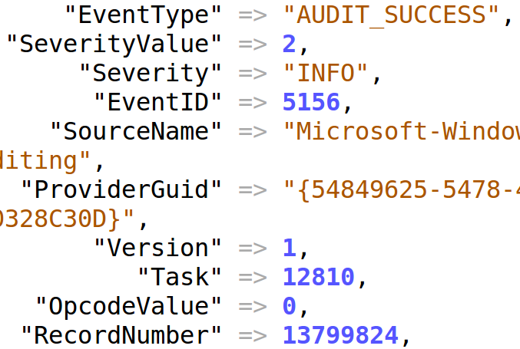
json - Filter Plugin
The easiest…the json plugin
json {
source => "message"}
}
That's all!
Windows logs have lots of fields, let JSON handle it!

Slide 60
Full Elastic Stack In a Nutshell
Send things to Logstash via agents or forwarding
Parse them in whatever way you want
Send them to Elasticsearch for storage
Query Elasticsearch via Kibana

Slide 61

Default Ports
HTTP
:5044
:5601
HTTP
:9200
:9300

Slide 62
Dual Stack SIEM

Slide 63

Logstash to Multiple SIEMs
Commercial SIEM
Logs
Elasticsearch

Slide 64
Logstash Log Pulling
Pull
Logs
Commercial SIEM
Elasticsearch

Slide 65

Message Broker to SIEM
Commercial SIEM
Log Agent
Logs
Elasticsearch

Slide 66
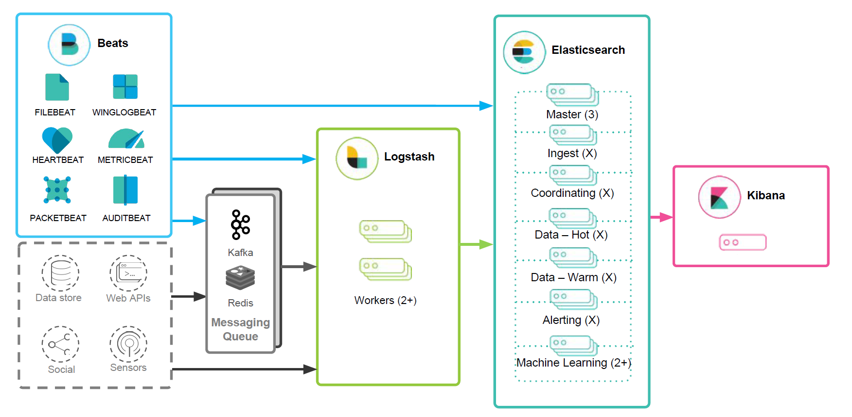
The Full Layout
https://www.elastic.co/assets/blt2614227bb99b9878/architecture-best-practices.pdf

Slide 67
Hardware
Backup Slides

Slide 68



CPU and Memory
Node RAM
How much CPU and memory are required?
Memory will run out first
Use as much as possible
8GB+ per node
64GB = sweet spot (Java limitations)
<=31GB dedicated to Java max
/etc/elasticsearch/jvm.options file
CPU – multi-core/node, 64bit
More cores better than faster speed
Heap
<=31GB
OS / Lucene
All
other RAM
See: https://www.elastic.co/guide/en/elasticsearch/reference/current/heap-size.html

Slide 69

Networking
You can never have too much bandwidth!
Moving 50GB shards node to node
Returning large query results
Restoring from backup
Network Setup:
1GB is required
10GB is better!
Minimize latency
Jumbo frames enabled

Slide 70

Hard Drives
Disk speed for logging clusters is VERY important
Lots of hard drives for high IO, not one big one
RAID0 setup, replica shards take care of availability

Slide 71
Thanks!

